Slide 1
Research

Slide 2
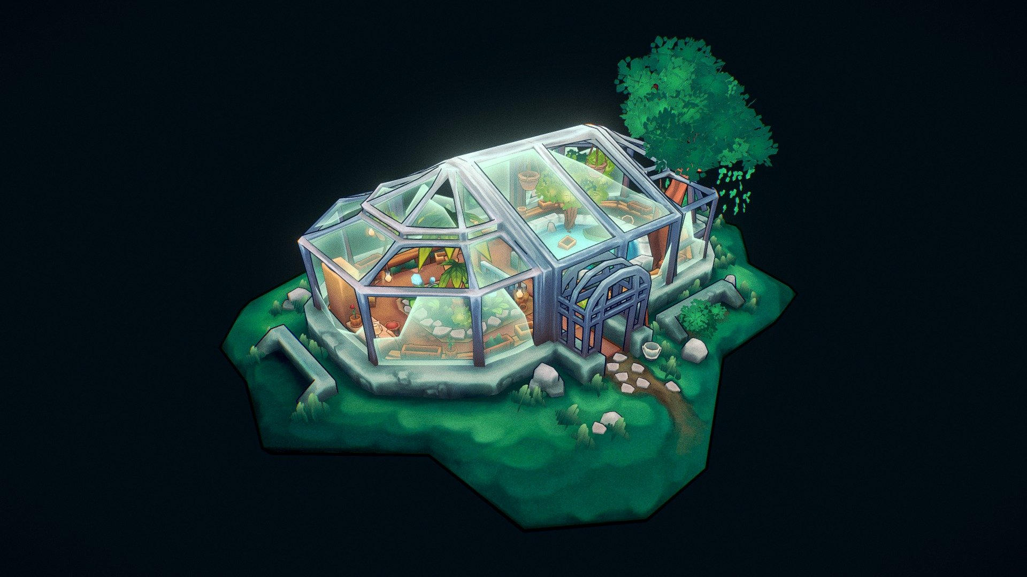
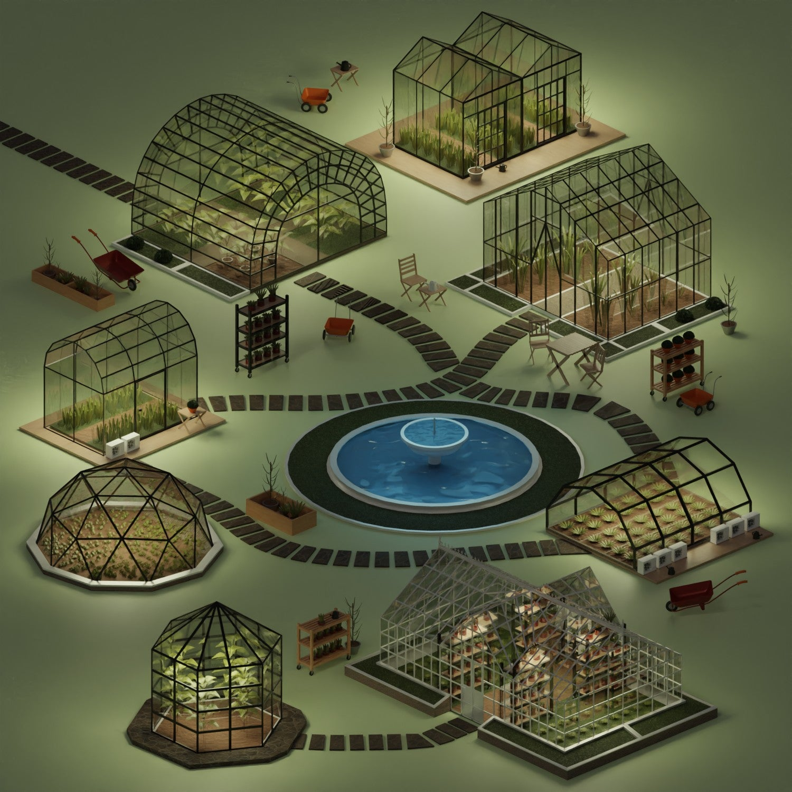
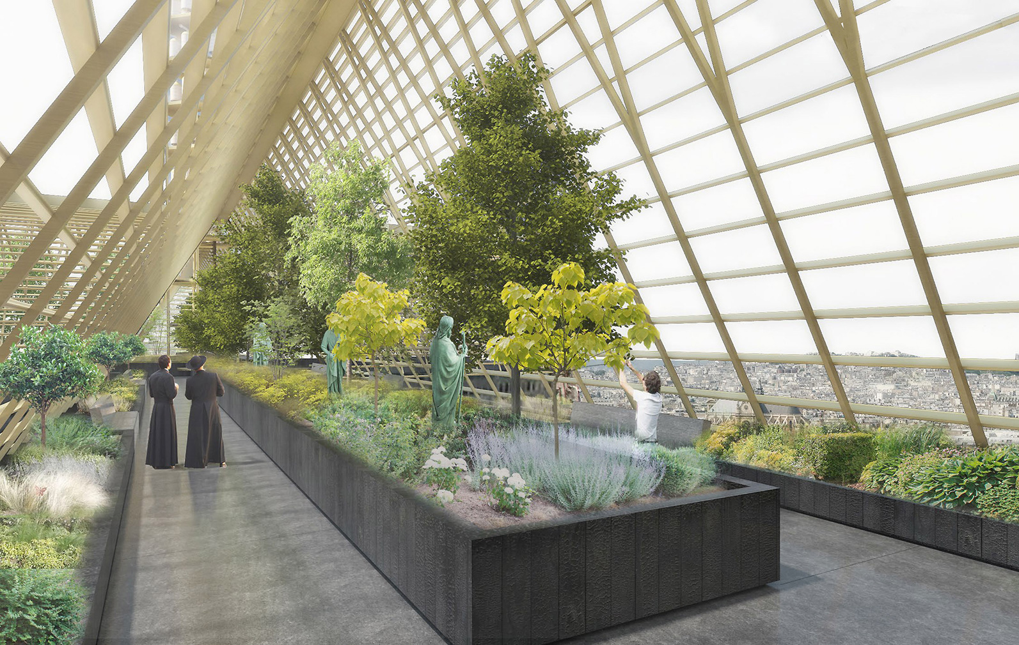
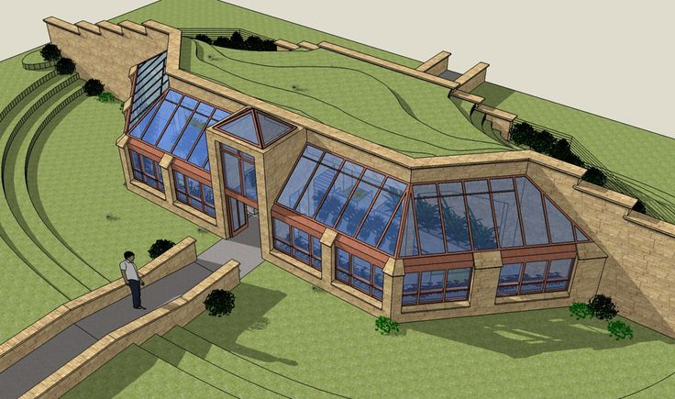
Environment
These are models of greenhouses, I will be taking inspiration from these in how I create the environment for my game, most of them use rectangular windows to form the shape they are looking for I will use rectangular windows too to build up the shape and for the interior there are a lot of mutated plants and greenery around

Slide 3
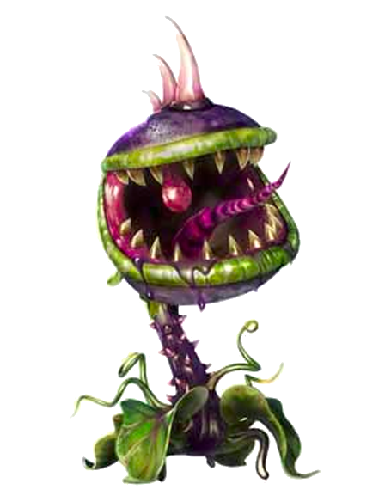

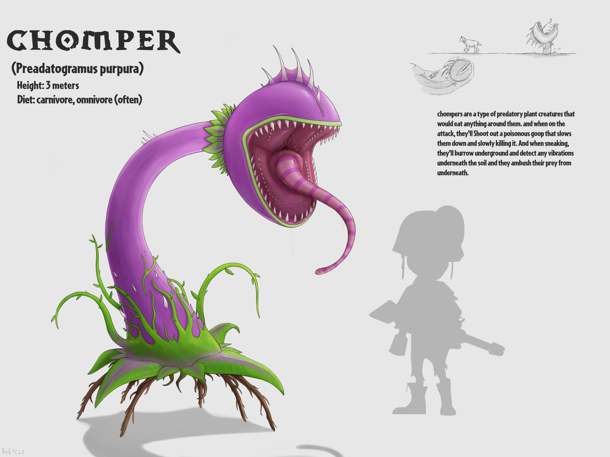
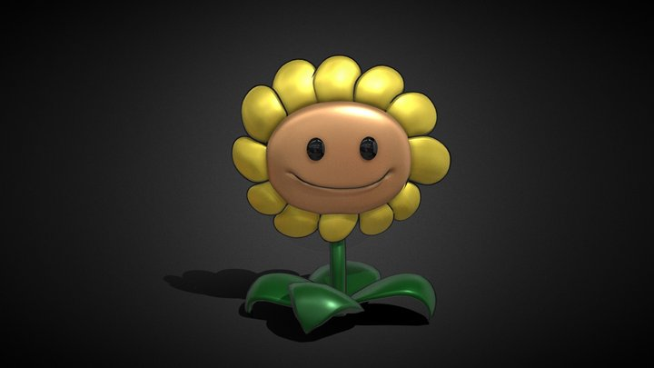
Plants
In these designs they all follow a similar style for a generailsed living plant design. I like the style of a plant with sharp teeth. I will be using a similar cartoony art style my designs will feature traditional animal features such as eyes and noses

Slide 4
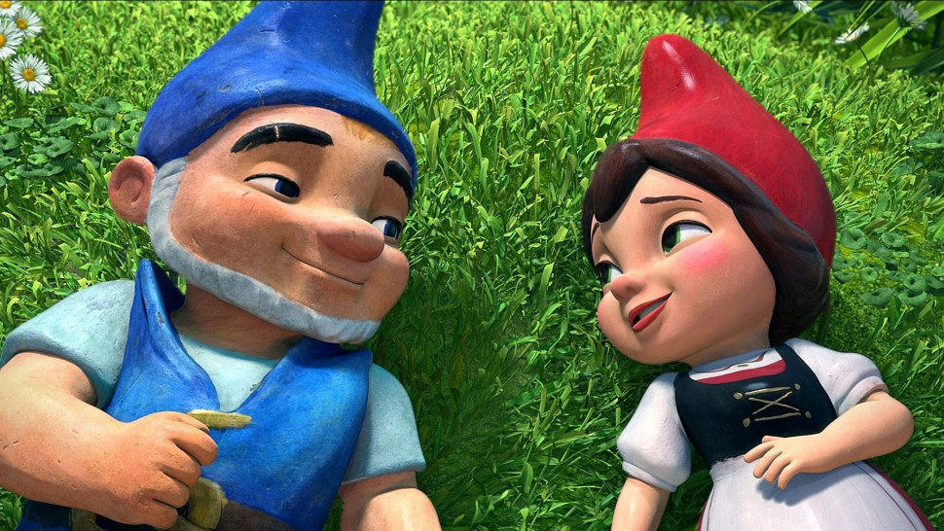
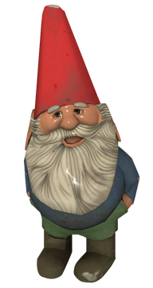
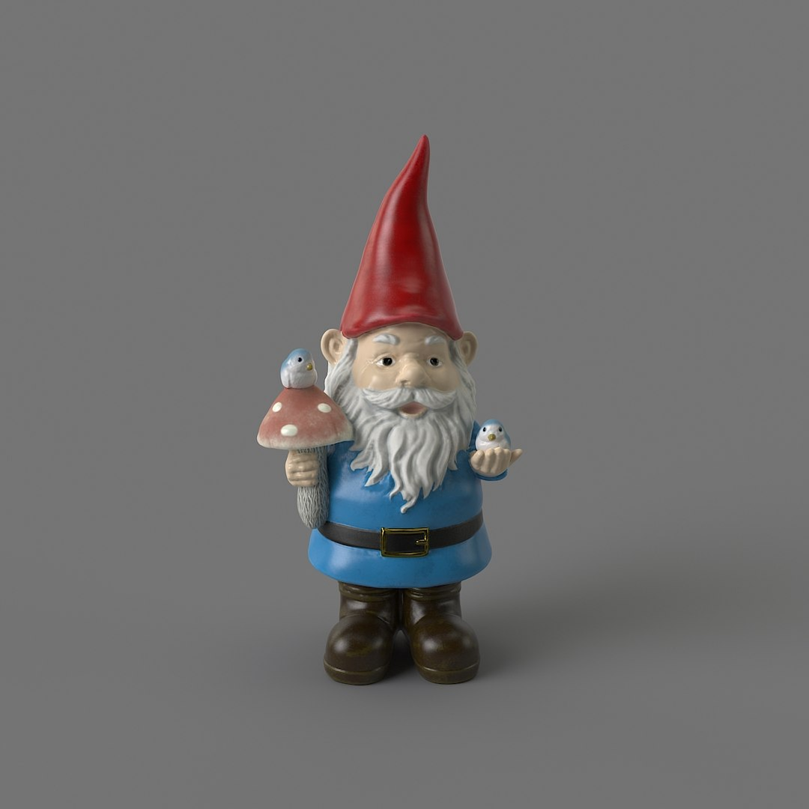
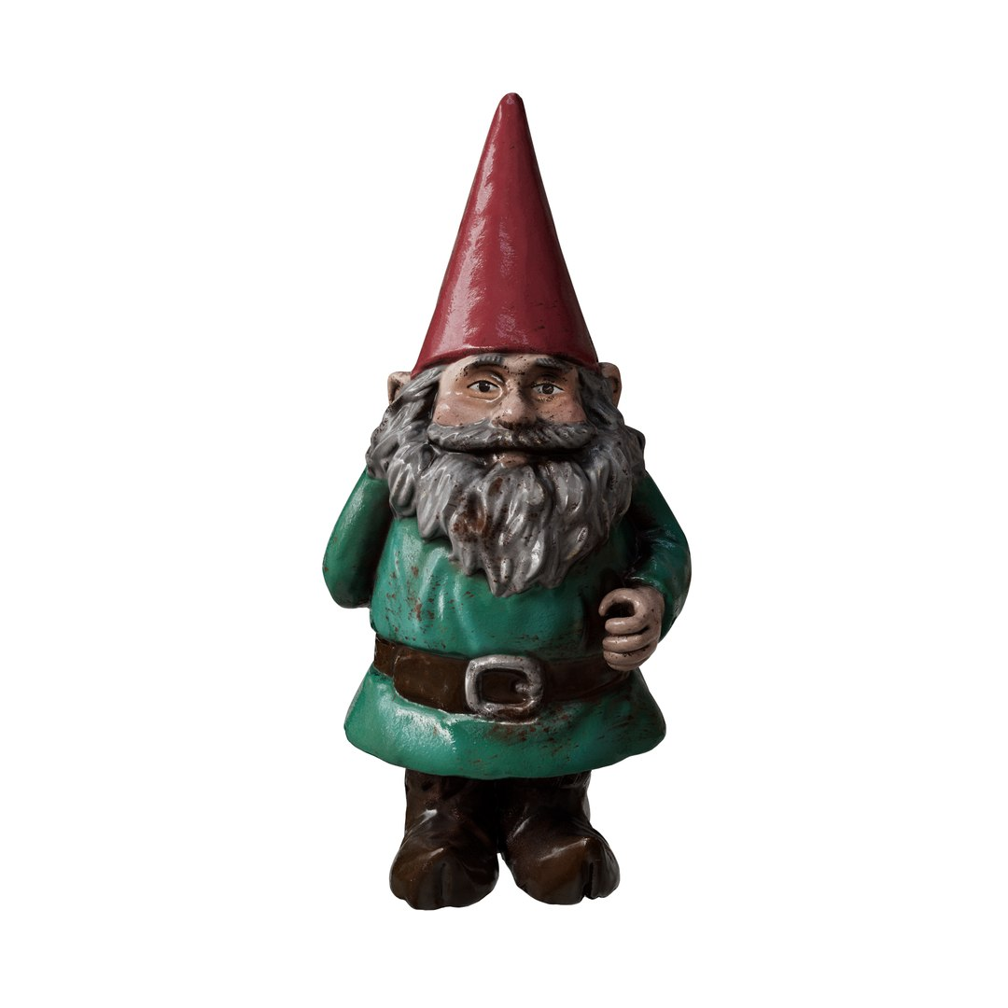
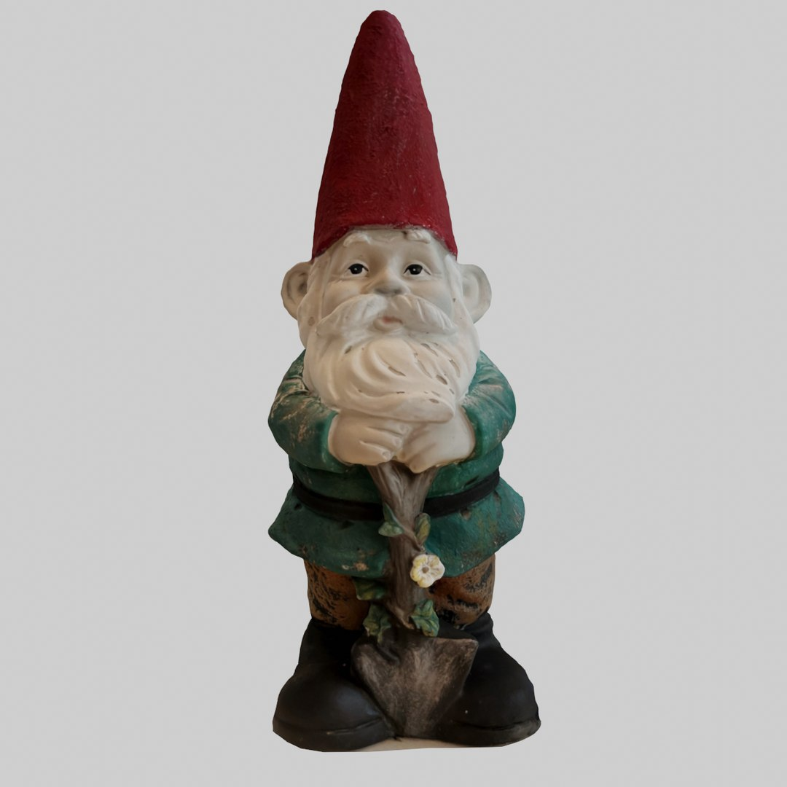
Gnomes
This is a bunch of gnomes that I am taking inspiration from, it is important for me to include the pointy red hat as all of the gnomes in this style have them. As well as this most of them have belts so I will include this too

Slide 5
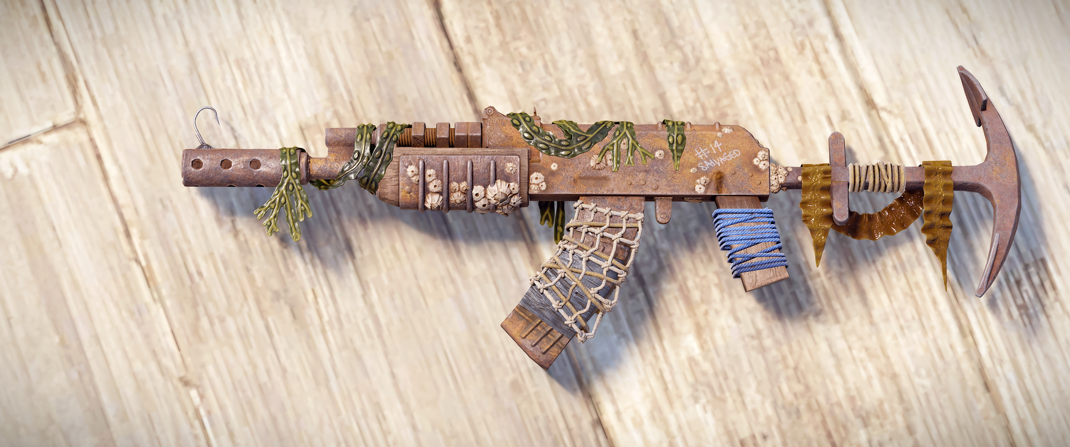
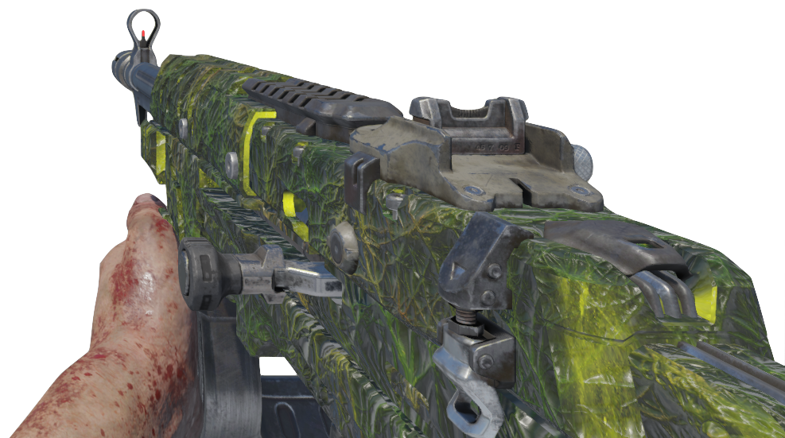
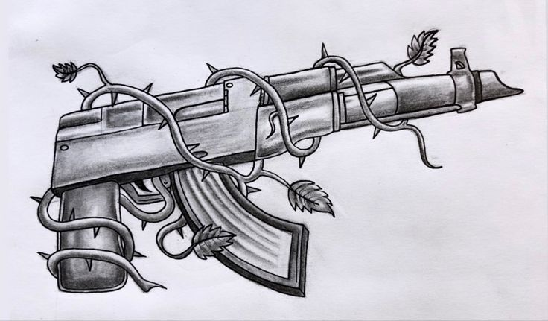
Guns
These guns have a specific look to them where vines wrap around the gun this is similar to how my upgraded guns will look in game, they will have a panning texture similar to black ops 3 zombies as a base colour for the gun and will have 3d vines wrap around the gun

